Slide 1

Face the Future: Deepfake ML Challenge
Team Name: Cadre | Date: October 20, 2025

Slide 2
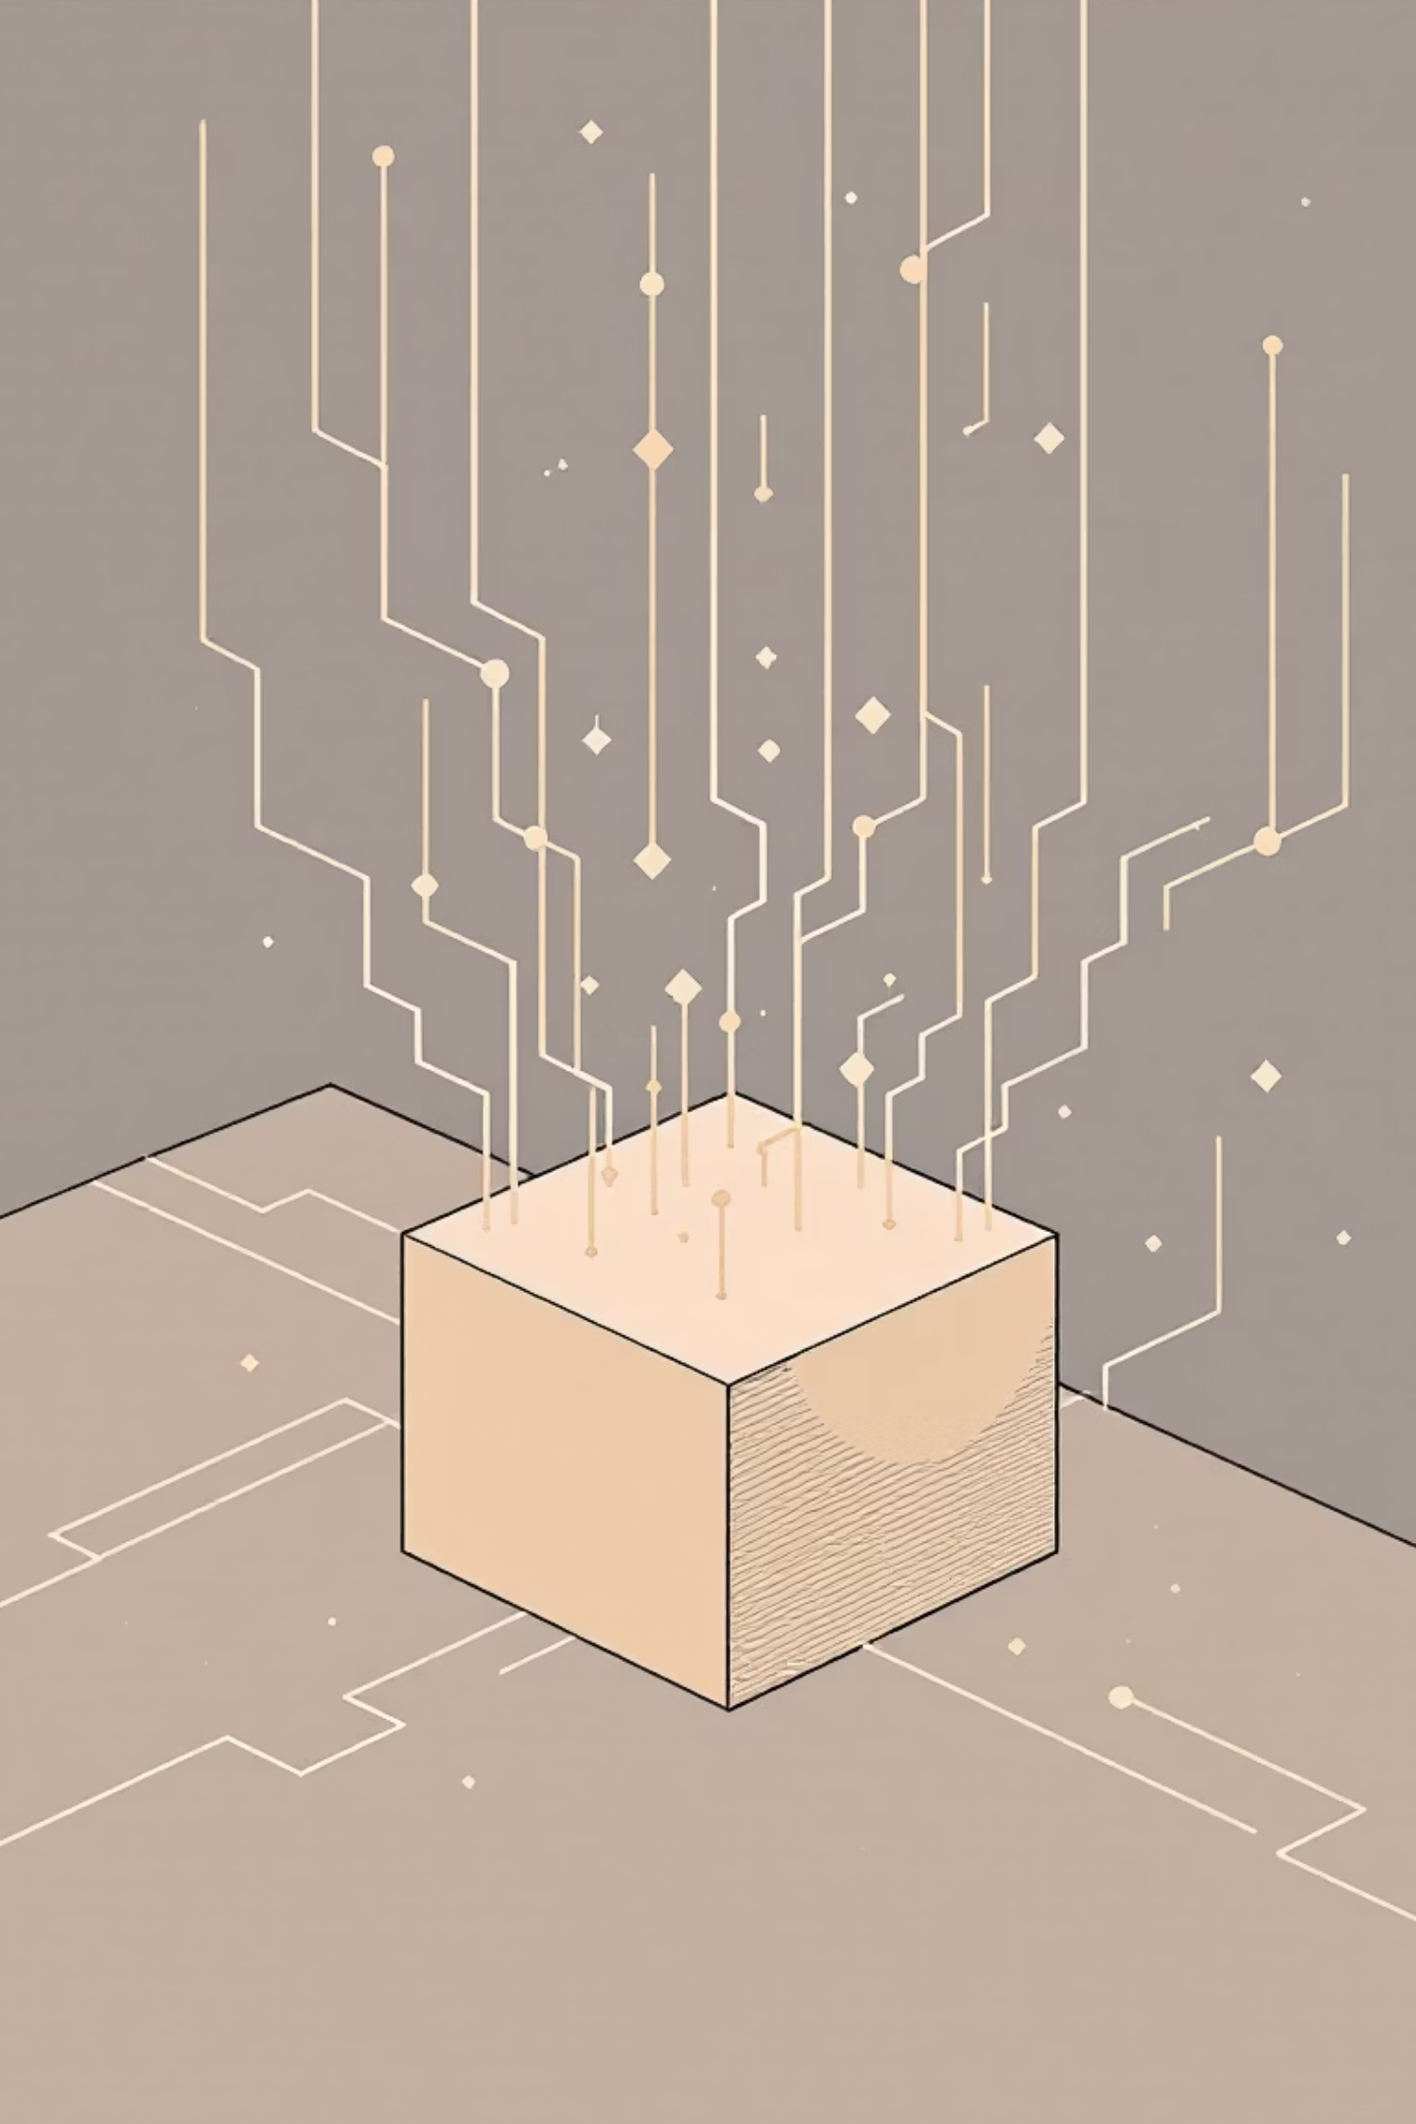
The Core Challenge: Emulating a Black-Box System
The Goal
Develop a predictive model to successfully emulate the outputs of a proprietary, "black-box" deepfake detection system.
The Task
Analyze training images and a JSON file to accurately replicate the proprietary model's specific judgments ("real" or "fake").

Slide 3
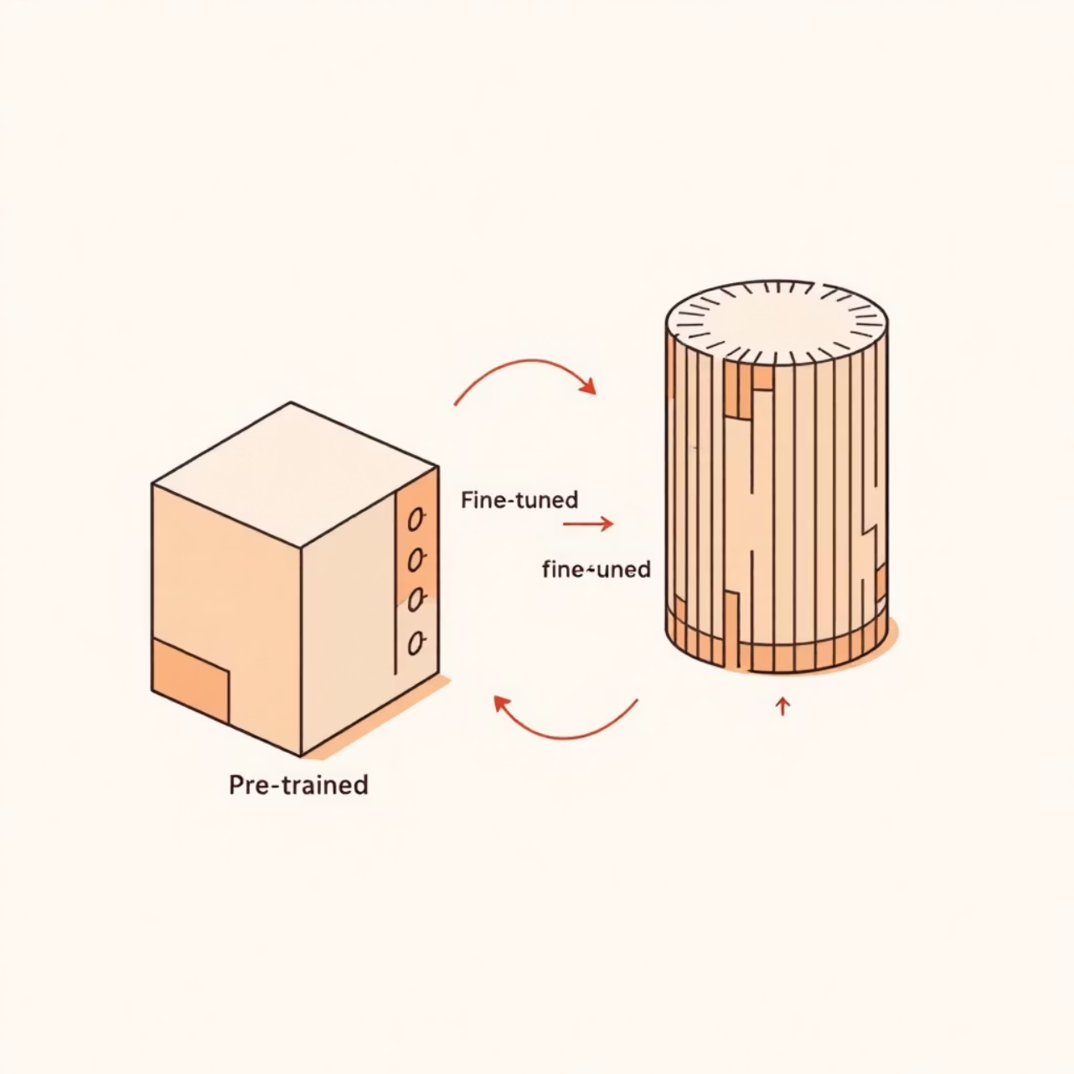
Our Strategy: Transfer Learning
To solve this complex "model-mimicking" problem, we adopted a Transfer Learning strategy.
This approach allowed us to leverage a massive, pre-existing knowledge base, saving significant training time and computational resources.
Our foundation model: MobileNetV2, pre-trained on the vast ImageNet dataset.

Slide 4


Why MobileNetV2?
High Accuracy
Provides a robust feature-extraction base, allowing our custom classifier to learn the subtle patterns distinguishing "real" vs. "fake" classifications.
Scalability & Efficiency
Lightweight architecture optimized for speed and a low memory footprint, meeting the challenge's preference for efficient models.

Slide 5

Methodology (1): Data Preparation
Organization
1
Programmatically sorted raw images into real/ and fake/ subdirectories for Keras ImageDataGenerator.
Augmentation
Applied real-time data augmentation to improve robustness and generalization.
2
Rotations (up to 25 degrees)
Width/Height Shifts (up to 20%)
Horizontal Flips
Splitting
3
Data automatically split into an 80% training set (1599 images) and a 20% validation set (399 images).

Slide 6

Methodology (2): Model Architecture
MobileNetV2
Classifier Head
Pre-trained base model (frozen)
Dense, Dropout, final sigmoid
Global Pooling
GlobalAveragePooling2D layer
Methodology (2): Model Architecture
Frozen Base
Pre-trained MobileNetV2 layers were frozen to preserve powerful, pre-learned weights.
Pooling Layer
GlobalAveragePooling2D condensed features, reducing parameters and preventing overfitting.
Classifier Head
Custom layers (Dense 128, Dropout 0.5) trained from scratch with a final Sigmoid output (0 to 1 probability).

Slide 7

Methodology (3): Training Process
1
Optimizer: Adam
Selected for its adaptive learning rate and fast convergence (Learning Rate: 0.001).
2
Loss Function
Binary_crossentropy, the standard for two-class classification, measuring distance between prediction and true label.
3
Epochs: 15
Optimal training duration found to balance maximizing accuracy and avoiding overfitting on validation data.

Slide 8

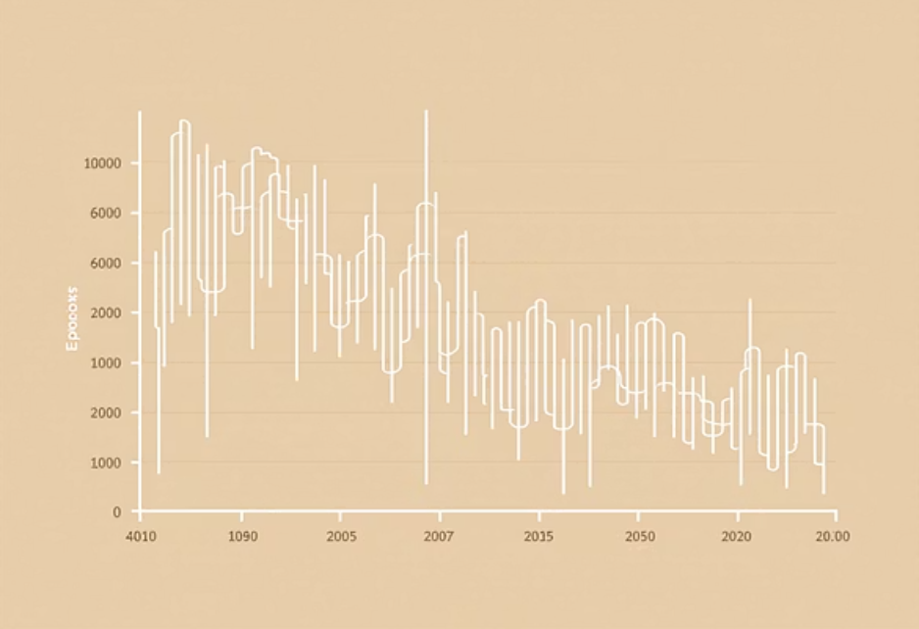
The Results: High Predictive Accuracy
82.55%
Final Validation Accuracy
Our model is highly effective at generalizing its learning and accurately mimicking the proprietary model's decisions on unseen data.
The training history confirmed a stable and effective learning process with a consistent increase in accuracy and decrease in loss.
The final model was used to generate the required Cadre_prediction.json file for all 500 images in the official test set.

Slide 9

Conclusion: Effective & Efficient Prediction
Transfer Learning Success
Requirements Met
The MobileNetV2 approach proved to be a highly effective and efficient solution for this unique predictive challenge.
Successfully built a system that accurately predicts the proprietary model's output, demonstrating high Accuracy and excellent Scalability.

Slide 10

Thank You
Team Cadre
We are ready for your questions.

